Slide 1
Weekly Progress Report – Construction Projects
Projects Department

Slide 2
Disclaimer
This report is not all inclusive, nor it is intended to address the entirety of construction progress. It is concerned primarily with construction progress and is intended to provide near term management information. The report itself serves as the Agenda for the weekly/Biweekly/Monthly or as required progress meetings.

Slide 3
Introduction

Slide 4
Introduction
Purpose
This report is to be prepared by the construction contractor and submitted to the Construction Consultant and MODON Project Manager before 12:00 PM on every Wednesdays with Progress data cut off date is monday. The premise behind this report and the key to successfully managing projects is to update schedules weekly.
Calendar
The complete report will serve as the agenda for the weekly site meetings. The Construction Manger will chair the meeting. Attendance shall be limited to essential personnel only. Construction Contractor, appropriate Contractor staff, Construction Manager, Program Manager, and MODON Project Manager shall be in attendance.
Minutes of Meeting will be taken by the Construction Manager and submitted to the Program Manager (If Applicable) within 48 hours. Minutes shall describe attendance, the conduct of the meeting, discussion items, and problem resolutions, and shall provide action items with responsible parties and due dates.
Construction Manager shall maintain the Action Items Register. At subsequent meetings, open action items shall be discussed first.

Slide 5
Weekly Progress Report Dashboard
Summary Dashboard
Weekly Progress Report Dashboard is an outcome for completing all the sheets within the weekly progress report file.
No manual input is needed for the summary sheet.
It is important that sheets should not be deleted or replaced. All input should be entered manually as a part of weekly update.

Slide 6
Weekly Progress Report Attachment
Weekly Progress Report Attachement
Contractor/Consultant should ensure that the weekly progress report are supported with required attachment.
Those attachment should include the following as a minimum requirement:
Approved Primavera P6 Schedule in .xer format.
3-5 latest progress photographs in JPG format
Updated Primavera P6 schedule in .xer format & PDF Format Three weeks look ahead in PDF format. (as per plf link)
Remaining Works in PDF format.
Any other supporting document required per the development of the project.

Slide 7
Weekly Report Areas / Sections

Slide 8
Weekly Report Areas / Sections
Contract General Information
HSE
Key Dates
Invoices
Progress Overview
Contract Change Order Log
Construction Milestones
Major Quantity Trackers
Submittals Status
Resources at Site
Shop Drawing Status
Primavera P6 Schedule Status
Material Approval Status
Testing And Commissioning
Quality
Top Issues

Slide 9
Weekly Report Areas / General Information
Contract General Information
Project Name | Development of the Technology City in DHAHRAN Project
Project ID | DHRT-01-001
Contractor | ANSAB CONTRACING
Consultant | EGIS
Stage | Construction
Status | Active
Modon PM | Engr. Afat Elanzey
Contract General Information
Project Name: Name of the Project as per contract
Project ID: Project ID assigned by MODON and available with MODON Project Manager.
Contractor: Company Name of the Contractor
Consultant: Company Name of the Consultant supervising the activities on site.
Stage: Stage of the project when reporting. Should be selected from Dropdown list.
Status: Current Status of project. Should be selected from Dropdown list.
MODON PM: Name of the MODON Project Manager assigned to the project.

Slide 10
Weekly Report Areas / Dates
Key Dates
Contract Award Date |  | 07-Dec-25
Contract Sign Date |  | 25-Dec-25
Site Handover Date |  | 06-Jan-26
Original Completion |  | 05-Mar-27
Contract Award Date (Hijri) |  | 16/06/1447
Contract Sign Date (Hijri) |  | 05/07/1447
Site Handover Date (Hijri) |  | 17/07/1447
Original Completion (Hijri) |  | 26/09/1448
Revised Completion Date |  | 05-Mar-27
Committed Completion Date |  | 05-Mar-27
Forecast Completion |  | 05-Mar-27
Variance |  | 0
Key Dates
Contract Award Date: Date of award contract per letter of award issued to the contractor.
Contract Sign Date: Date of the contract signing as shown in contract signed.
Site Handover Date: Date of site handover to the contractor per site handover letter.
Original Completion: Contractual Finish Date (Original as per contract signed)
Revised Completion Date: Contractual Finish Date with all extension of Time (EOT) if approved otherwise same as original finish date.
Committed Completion Date: Contractor commitment date to complete the project.
Forecast Completion: Forecast Finish Date calculated by Primavera 6 (scheduling software) from the current updated schedule
Variance: No entry required, will be calculated automatically.

Slide 11
Weekly Report Areas / Dates
Key Project Submittals | Submission Date | Days taken to approve original plan from site handover date
Quality Plan submission | 8-Jan-26 | 34
Quality Plan approval | 9-Feb-26
Quality Plan Last Update | 9-Feb-26
Key Dates
Safety Plan submission | 8-Jan-26 | 28
Safety Plan approval | 3-Feb-26
Safety Plan Last Update | 3-Feb-26
Quality Plan submission: Original Quality Plan submission date by contractor
Quality Plan approval: Original Quality Plan Approval date by MODON
Quality Plan Last Update: Latest Quality Plan Approval date by MODON
Safety Plan submission: Original Safety Plan submission date by contractor
Safety Plan approval: Original Safety Plan Approval date by MODON
Safety Plan Last Update: Latest Safety Plan Approval date by MODON
Risk Management Plan submission: Original Risk Plan submission date by contractor
Risk Management Plan approval: Original Risk Plan Approval date by MODON
Risk Management Plan Last Update: Latest Risk Plan Approval date by MODON
Baseline Schedule submission: Original Baseline Schedule submission date by contractor
Baseline Schedule approval: Original Baseline Schedule Approval date by MODON
No of Schedule Versions: Schedule versions approved for the duration of the project.
Last Schedule Approval Date: Latest Recovery Schedule Approval date by MODON
BOQ submission: Original BOQ submission date by contractor
BOQ approval: Original BOQ approval date by contractor
No of Approved Version of BOQ: BOQ Version approved for the duration of the contract.
Construction Plan submission : Construction Plan submission date by contractor
Construction Plan Approval : Construction Plan approval date from MODON.
Risk Management Plan submission | 8-Jan-26 | 28
Risk Management Plan approval | 3-Feb-26
Risk Management Plan Last Update | 3-Feb-26
Baseline Schedule submission | 5-Feb-26 | 68
Baseline Schedule approval | 15-Mar-26
No of Schedule Versions | 1
Last Recovery Schedule Approval Date | 23-Jun-26
Construction Plan submission | 15-Jan-26 | 9
Construction Plan Approval | 15-Jan-26

Slide 12
Weekly Report Areas / Progress
Provide the project scope statement and WBS deliverable information. Note that you WBS details can be broken to the convenient level as required and agreed with Modon PM. A precaution is required as this is linked to summary dashboard. Avoid deleting WBS-Level 1 rows any number of rows can be added in WBS Level-2 sections. Check with Modon Project controls if further clarity is required.
Progress Overview
WBS: Deliverables as per Modon Work Breakdown Structure (WBS) and WBS dictionary (Same in P6)
BoQ Value (SAR) Value of every WBS element so that total value is equal to the current approved value of the current.
%Wt.: No Entry required – Percentage of each WBS item based on total contract value.
Weekly Planned: Weekly Planned Value of the element derived from scheduling software
Weekly Earned: Weekly Value of the deliverables accomplished, derived from scheduling software
ToDate Planned: ToDate Planned Value of the element derived from scheduling software
ToDate Earned: ToDate Value of the deliverables accomplished, derived from scheduling software

Slide 13
Weekly Report Areas / Progress
Progress Overview
Budgeted Effort (Manhours): Total Manhours/Mandays planned per WBS and loaded in P6. Select from Manhours/Mandays drop down list as applicable.
%Wt.: No Entry required – Percentage of each WBS item based on total manhours/mandays.
Weekly Planned: Weekly Planned effort of the element derived from scheduling software
Weekly Earned: Weekly effort of the deliverables accomplished, derived from scheduling software
ToDate Planned: ToDate Planned effort of the element derived from scheduling software
ToDate Earned: ToDate effort of the deliverables accomplished, derived from scheduling software

Slide 14
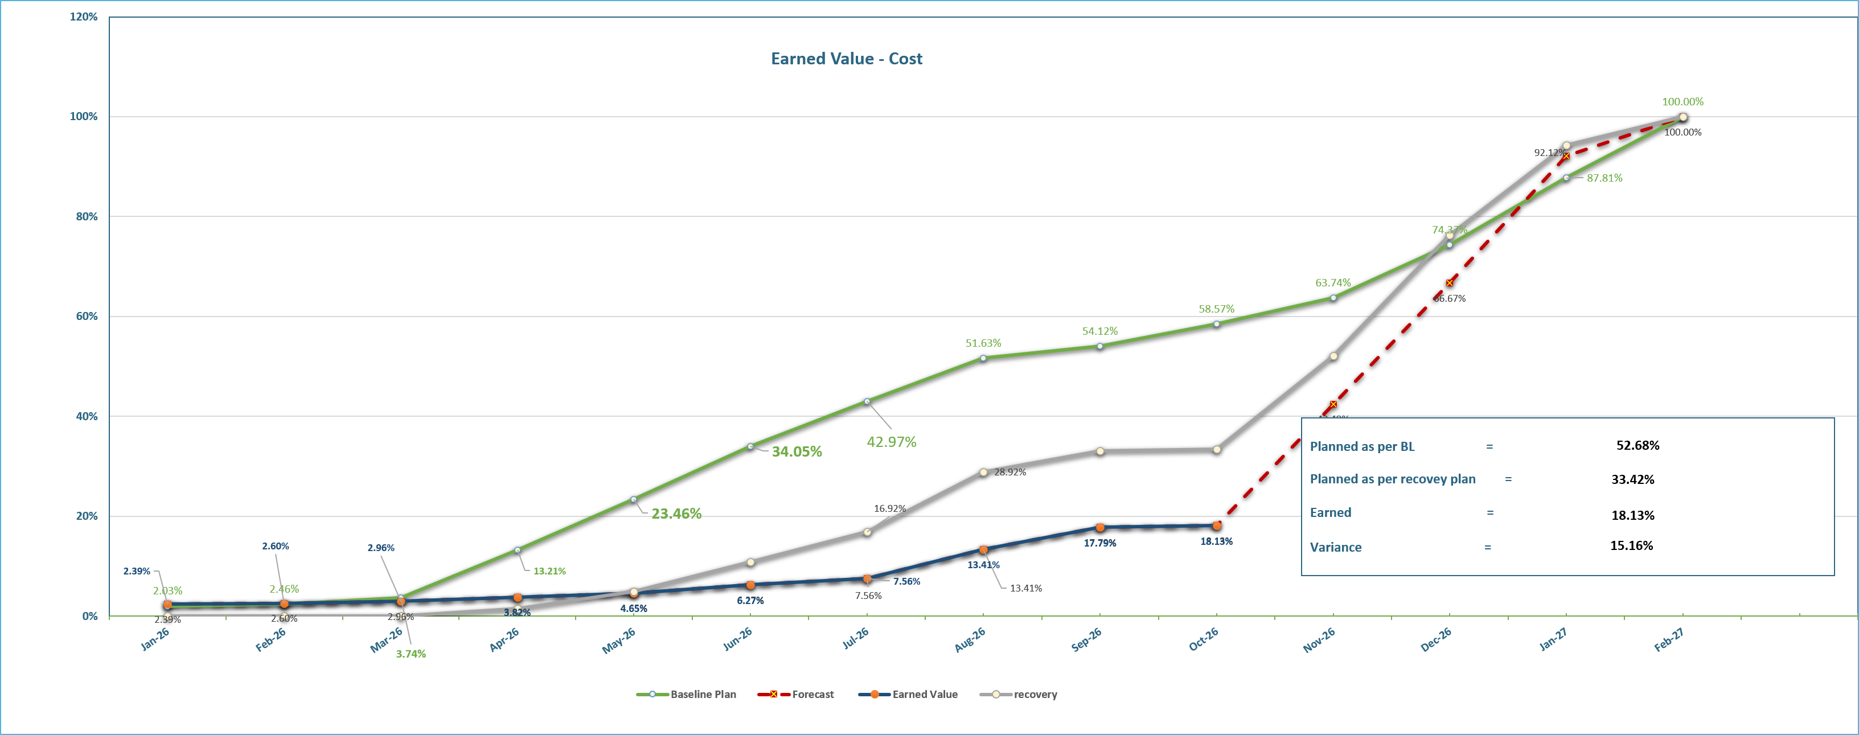
Weekly Report Areas / Progress
Progress Overview
Following Cumulative Curves should be plotted; Value (SAR) in %age against Time for:
Base line or Original Plan
Revised Plan (Only if EOT/CO is approved by MODON through change management)
Earn Value for the work accomplished
Forecast Curve
Gross Paid Value (Invoices)
Note that the data entry for the curves is in sheet named “EV-Chart Data”. All the four curves should have data from P6 except for the invoices those should be entered manually every month.

Slide 15
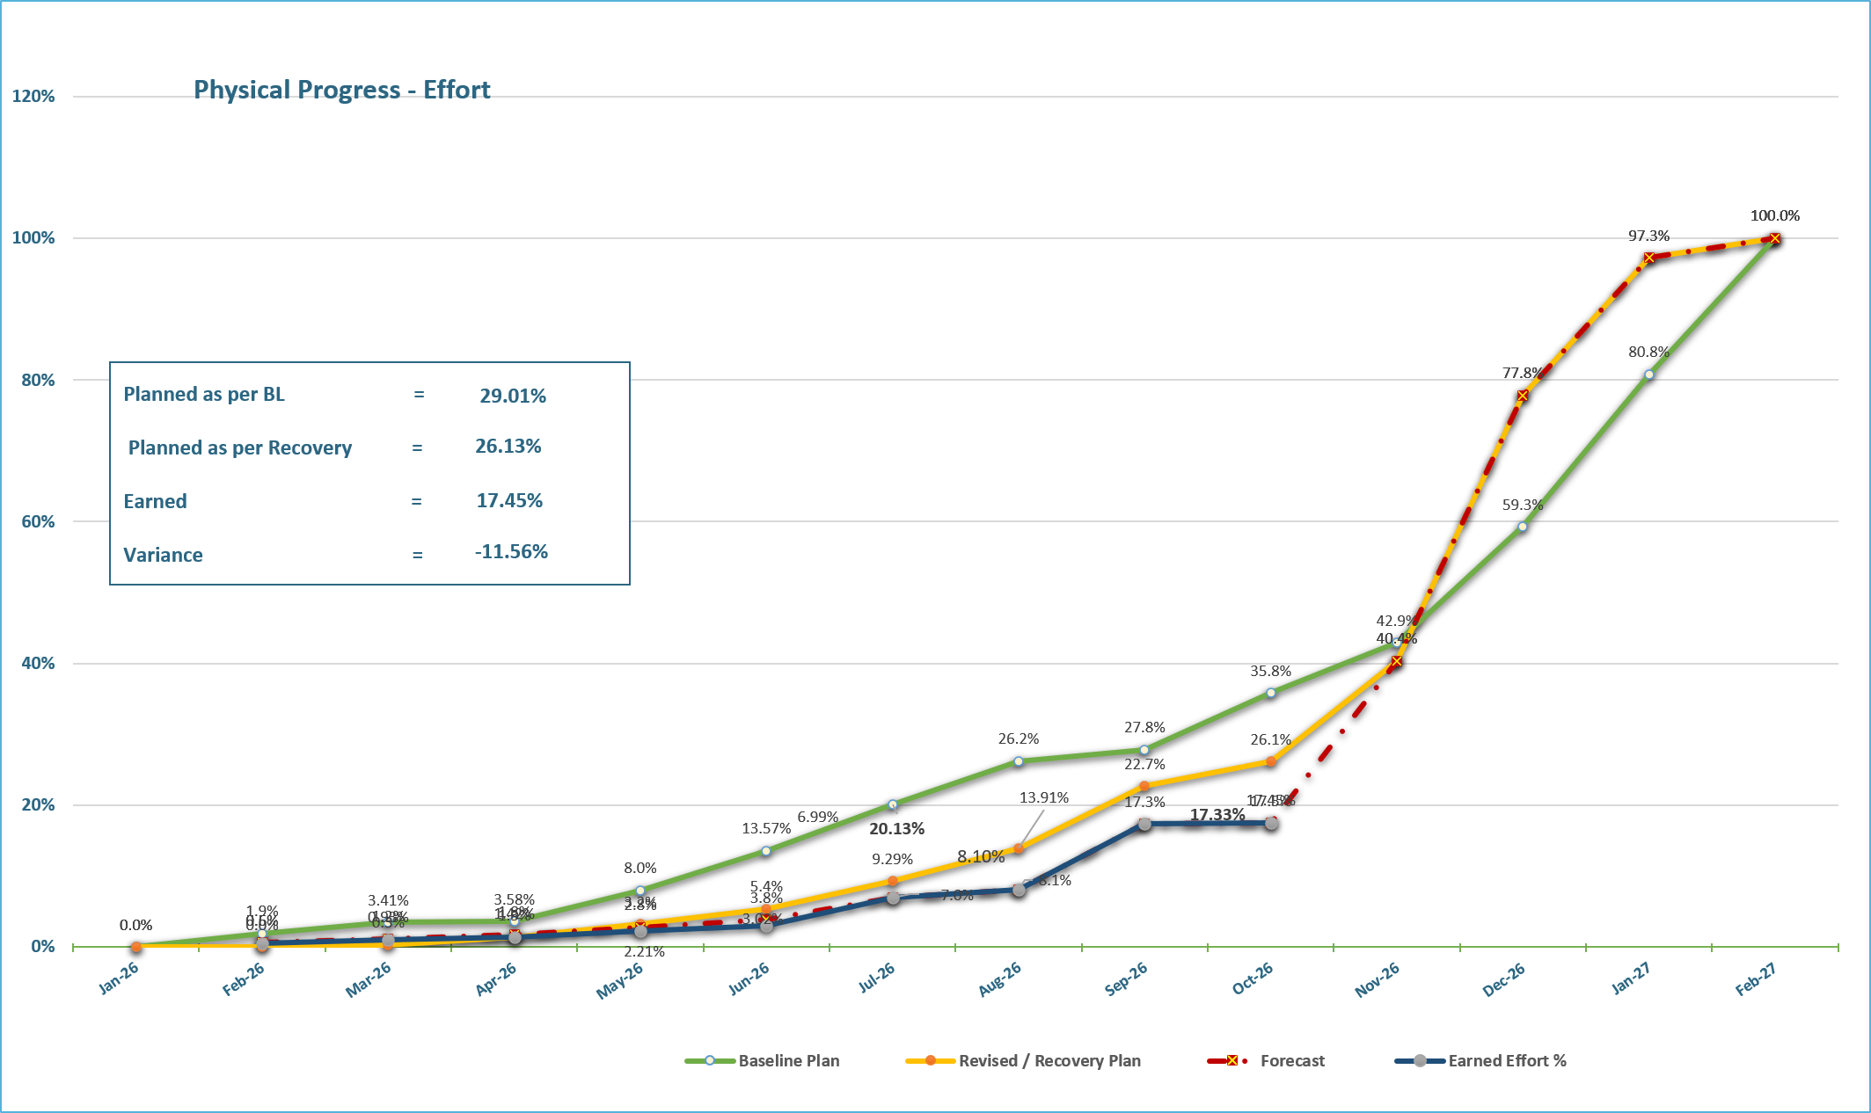
Weekly Report Areas / Progress
Progress Overview
Note that the data entry for the curves is in sheet named “Physical-Chart Data”. All the four curves should have data from P6.
Following Cumulative Curves should be plotted; Labor units in %age against Time for:
Base line or Original Plan Effort (Manhours/Mandays whatever is applicable)
Revised Plan (Only if EOT/CO is approved by MODON (Manhours/Mandays whatever is applicable)
Earned manhour or mandays for the work accomplished. (Not the Actual manhours or mandays spent on site)
Forecast Curve for the remaining period of time

Slide 16
Weekly Report Areas / Milestones
Development of the Technology City in Dhahran Project
Item No. | Milestones | Original (Baseline) | Latest | Forecast | Status | Days Change
 | Contract Duration Current Contract Weeks : 35 of 60 | 60 | 60 | 60 |  | 0
1 | Project Commencement Date ( Site Handover ) | 06-Jan-26 | 06-Jan-26 | 06-Jan-26 | A | 0
2 | Completion of Execution Plan and Baseline Schedule | 05-Feb-26 | 05-Feb-26 | 05-Feb-26 | A | 0
3 | Completion of Submitting and Approval of Shopdrwing and Material | 16-Feb-26 | 16-Feb-26 | 16-Feb-26 | F | 0
4 | Completion of Mobilization Works | 08-Mar-26 | 08-Mar-26 | 08-Mar-26 | F | 0
5 | Completion of Construction Works for Potable Water Network | 14-Dec-26 | 14-Dec-26 | 14-Dec-26 | F | 0
6 | Completion of Construction Works for Storm Drainage Network | 13-Jan-27 | 13-Jan-27 | 13-Jan-27 | F | 0
7 | Completion of Construction Works for Irrigation Network | 27-Dec-26 | 27-Dec-26 | 27-Dec-26 | F | 0
8 | Completion of Construction Works for Sewage Network | 26-Jan-27 | 26-Jan-27 | 26-Jan-27 | F | 0
9 | Completion of Construction Works for Treated Sewage Effluent Network | 26-Jan-27 | 26-Jan-27 | 26-Jan-27 | F | 0
10 | Completion of Construction Works for Medium Voltage Network | 07-Jan-27 | 07-Jan-27 | 07-Jan-27 | F | 0
11 | Completion of Construction Works for Street Lighting Network | 09-Feb-27 | 09-Feb-27 | 09-Feb-27 | F | 0
12 | Completion of Construction Works for Telecom Network | 11-Jan-27 | 11-Jan-27 | 11-Jan-27 | F | 0
13 | Project Completion Date | 05-Mar-27 | 05-Mar-27 | 05-Mar-27 | F | 0
Construction Milestones
Contractor to list all important milestones upon agreement with consultant and MODON to track the status of such milestones. The construction milestones should be included into P6 data and information should extracted weekly.
Status should be update manually for Actuals as “A” and forecast as “F”

Slide 17
Weekly Report Areas / Submittals
Shop Drawings
Item Per WBS | Total | Total Drawings Submitted |  |  |  |  | Remaining Drawings | Pending | Total Submittals
 |  | A | B | C | D | Processed |  | Submittals With Consultant
Civil | 4 | - | 2 | 2 | - | - | - | - | 4
Structural | 11 | - | 10 | - | - | - | - | 1 | 11
Architectural | 6 | - | 6 | - | - | - | - | - | 6
Mechanical | 21 | - | 21 | - | - | - | - | - | 21
Electrical | 11 | - | 11 | - | - | - | - | - | 11
TOTAL | 53 | - | 50 | 2 | - | - | - | 1 | 53
Submittals Status
Contractor should be able to determine all the shop drawing needed for the project and categorize it into disciplines or per approved WBS.
Total : Total shop drawing needed for the specified WBS.
Total Processed Drawings Codes (A,B,C,D) : Number of each reviewed shop drawing per code.
Remaining Drawings: Number of shop drawing remaining that has not been submitted by the contractor.
Pending Submittal with Consultant: number of shop drawing that has been submitted by the contractor and still pending with consultant under review.
Total Submittals: is calculated cell that sums up all the processed shop drawing.

Slide 18
Weekly Report Areas / Shop Drawings
Material Approval
Item Per WBS | Total | Total Materials Submitted |  |  |  |  | Remaining to approve | Pending | Total Submittals
 |  | A | B | C | D | Processed |  | Submittals With Consultant
Civil | 1 |  |  |  | 1 | - | 1 | - | 1
Structural | - |  | - | - |  | - | - | - | -
Architectural | - |  |  |  |  | - | - | - | -
Mechanical | 12 |  | 4 | 3 |  | - | 5 | 5 | 12
Electrical | 6 |  | 1 | 4 | 1 | - | 1 | - | 6
TOTAL | 19 | - | 5 | 7 | 2 | - | 7 | 5 | 19
Shop Drawings
Contractor should be able to determine all the shop drawing needed for the project and categorize it into disciplines or per approved WBS.
Total : Total shop drawing needed for the specified WBS.
Total Processed Drawings Codes (A,B,C,D) : Number of each reviewed shop drawing per code.
Remaining Drawings: Number of shop drawing remaining that has not been submitted by the contractor.
Pending Submittal with Consultant: number of shop drawing that has been submitted by the contractor and still pending with consultant under review.
Total Submittals: is calculated cell that sums up all the shop drawing reviewed.

Slide 19
Weekly Report Areas / Materials
Material Approval
Contractor should be able to determine all the material that will require prior approval for the project and categorize it into disciplines or per approved WBS.
Total : Total material submittal needed for the specified WBS.
Total Processed Material Codes (A,B,C,D) : Number of each material reviewed per code.
Remaining to Approve: Number of Material submittals remaining that has not been submitted by the contractor.
Pending Submittal with Consultant: number of Material submittals that has been submitted by the contractor and still pending with consultant under review.
Total Submittals: is calculated cell that sums up all the material submittals approval reviewed.

Slide 20
Weekly Report Areas / Quality
Quality Reports
Item | Issued | Closed | Pending | Avg. Closing (Days) | Pending
 |  |  |  |  | 0-10 Days | 11-20 Days | 21-30 Days | 31-60 Days | > 60 Days
Non Conformance Report (NCR) | 4 | - | 4 |  | NCR 4 | - | - | NCR1,2,3 | -
Site Instruction (SI) | 5 | - | 5 |  | - | - | - | - | -
Material Inspection Report (MIR) | - | - | - |  | - | - | - | - | -
Field Inspection Report (FIR) | 3 | 3 | - |  | - | - | - | - | -
Quality Reports
This section is designed to track the number and status of Non Conformance Report (NRC), Site Instructions (SI), Material Inspection Reports (MIR) and Field Inspection Reports (FIR).
Issued : Total items issued by contractor/consultant.
Closed : Total items that has been addressed properly and closed by consultant.
Pending: Total items that are pending action with contractor/consultant that require further action to be properly closed.
Average Closing in Days: This should calculate the actual average duration to close the items in the closed category .
Pending (Duration): This should calculate the pending items status in terms of duration elapsed within contractor/consultant.

Slide 21
Weekly Report Areas / Quality
Note that the Quality checklist may get updated from Modon Quality department from time to time. Site planner to confirm with Modon Project Controls if he has the latest checklist
 | QC OBSERVATIONS CHECKLIST
 | Project No. |  |  | DHRT-02-001 |  |  |  |  |  | OBS No. |  |  |  | 10 |  |  |  |  |  | Inspection Day: |  |  | 14-Apr-26
 | Project |  |  | Development of the Technology City in DHAHRAN Project |  |  |  |  |  |  |  |  |  | Contractor: Consultant: |  |  |  |  |  | ANSAB GENERAL CONTRACTING EGIS
 | 4 |  | Excellent |  |  | Quality Management System is being practiced and applies to MODON System |  |  |  |  |  |  |  |  |  |  |  |  |  |  |  |  |  |  | 90 - 100 |  | QC Overall Score | 84%
 | 3 |  | Good |  |  | Evidence of compliance with plans and procedures. |  |  |  |  |  |  |  |  |  |  |  |  |  |  |  |  |  |  | 80 - 89
 | 2 |  | Average |  |  | Indication level of compliance with standards but there is room for improvement |  |  |  |  |  |  |  |  |  |  |  |  |  |  |  |  |  |  | 70 - 79
 | 1 |  | Improve |  |  | Quality and Control is NOT being managed effectively. Needs Improvement |  |  |  |  |  |  |  |  |  |  |  |  |  |  |  |  |  |  | ≤ 69
 | 0 |  | N/A |  |  | Item was not applicable or this item was not reviewed during the inspection. |  |  |  |  |  |  |  |  |  |  |  |  |  |  |  |  |  |  | Zero
 | No. | Topic |  |  |  |  |  |  |  | E (4) | G (3) | A (2) | I (1) | N/A (0) |  | No. | Topic |  |  |  |  |  |  |  | E (4) | G (3) | A (2) | I (1) | N/A (0)
 |  |  |  |  |  |  |  |  |  | 100% | 89% | 79% | 69% | 100% |  |  |  |  |  |  |  |  |  |  | 100% | 89% | 79% | 69% | 100%
 | 1 | Control of Access to Site/Office |  |  |  |  |  |  |  | 0 | 1 | 0 |  |  |  | 30 | QC of Excavation |  |  |  |  |  |  |  |  | 0 | 1 |  | 0
 | 2 | Document Control Administration |  |  |  |  |  |  |  | 0 | 1 |  | 0 |  |  | 31 | QC of Roads/Round about |  |  |  |  |  |  |  |  |  | 0 |  | 1
 | 3 | Project Documents and Progress |  |  |  |  |  |  |  | 0 | 1 |  | 0 |  |  | 32 | QC of Interlock & Curbstone |  |  |  |  |  |  |  |  |  |  |  | 1
 | 4 | Contractor's Quality Plan/CM (Updated and Reviewed) |  |  |  |  |  |  |  |  | 1 | 0 |  |  |  | 33 | Layers/Backfilling Sampling |  |  |  |  |  |  |  |  |  | 0 |  | 1
 | 5 | MS Log and Paperwork |  |  |  |  |  |  |  | 0 | 1 |  |  |  |  | 34 | Pump Stations Units |  |  |  |  |  |  |  |  |  | 0 |  | 1
 | 6 | RFI, FIR, & MIR Procedure |  |  |  |  |  |  |  |  | 0 | 1 |  |  |  | 35 | Quality of Form Work |  |  |  |  |  |  |  |  |  |  | 0 | 1
 | 7 | RFI, FIR, & MIR Inventory system |  |  |  |  |  |  |  |  | 0 | 1 |  |  |  | 36 | Design Change List |  |  |  |  |  |  |  |  |  |  |  | 1
 | 8 | NCRs Control & Procedure |  |  |  |  |  |  |  |  |  | 0 | 1 |  |  | 37 | Quality of Concrete Placing |  |  |  |  |  |  |  |  |  | 0 | 0 | 1
 | 9 | NCR Log |  |  |  |  |  |  |  |  |  | 0 | 1 |  |  | 38 | Concrete Surface Finishing |  |  |  |  |  |  |  |  |  |  | 0 | 1
 | 10 | MODON Standard* |  |  |  |  |  |  |  |  | 1 | 0 | 0 |  |  | 39 | Pedestals/Columns/Beams Alignment |  |  |  |  |  |  |  |  |  | 0 |  | 1
 | 11 | Project Risk Plan/Management* |  |  |  |  |  |  |  |  | 1 | 0 | 0 |  |  | 40 | Siporex Lifting & Unloading |  |  |  |  |  |  |  |  |  |  |  | 1
 | 12 | Monthly Quality Reports* |  |  |  |  |  |  |  |  | 1 | 0 |  |  |  | 41 | Siporex Quality Pre-installation |  |  |  |  |  |  |  |  |  |  |  | 1
 | 13 | ITP |  |  |  |  |  |  |  |  |  | 1 |  |  |  | 42 | Siporex Finishing Quality |  |  |  |  |  |  |  |  |  |  |  | 1
 | 14 | MODON Weekly Report |  |  |  |  |  |  |  | 0 | 0 |  | 1 |  |  | 43 | Roads / Parking Markings |  |  |  |  |  |  |  |  |  |  |  | 1
 | 15 | Design Change Official Paperwork* |  |  |  |  |  |  |  |  |  | 0 |  | 1 |  | 44 | QC of Finishing Outdoors |  |  |  |  |  |  |  |  |  |  | 0 | 1
 | 16 | Design Change was Applied* |  |  |  |  |  |  |  |  |  | 0 |  | 1 |  | 45 | Quality of Finishing Indoors |  |  |  |  |  |  |  |  |  | 0 | 0 | 1
 | 17 | Material List |  |  |  |  |  |  |  |  | 1 | 0 |  | 0 |  | 46 | Stairs Quality |  |  |  |  |  |  |  |  |  | 0 | 0 | 1
 | 18 | Pending Material Status |  |  |  |  |  |  |  |  | 1 |  | 0 |  |  | 47 | Tanks Method Statement Work |  |  |  |  |  |  |  |  |  |  | 0 | 1
 | 19 | Lifting Plan* |  |  |  |  |  |  |  |  |  | 0 |  | 1 |  | 48 | Electric Rooms |  |  |  |  |  |  |  |  |  |  | 0 | 1
 | 20 | DWG Log |  |  |  |  |  |  |  |  | 1 |  |  |  |  | 49 | QC of MCC/ATS Plant Units |  |  |  |  |  |  |  |  |  |  |  | 1
 | 21 | Invoice Status |  |  |  |  |  |  |  | 0 | 0 |  | 0 | 1 |  | 50 | Qualified Subcontractor |  |  |  |  |  |  |  |  |  | 0 |  | 1
 | 22 | Site Handover Letter |  |  |  |  |  |  |  |  |  |  |  | 1 |  | 51 | Scaffold/Ladders/Slope/Bridge Compliance |  |  |  |  |  |  |  |  |  |  | 0 | 1
 | 23 | Material Testing Results & Certification |  |  |  |  |  |  |  |  |  |  | 0 | 1 |  | 52 | Protection Applied to Completed Work |  |  |  |  |  |  |  |  |  | 1
 | 24 | As Build Drawings Status* |  |  |  |  |  |  |  |  |  |  |  | 1 |  | 53 | Storage Management in/out Control |  |  |  |  |  |  |  |  | 0 | 1
 | 25 | Calibrated Lab Tools & Equipment |  |  |  |  |  |  |  |  | 1 |  |  | 0 |  | 54 | Material Control |  |  |  |  |  |  |  |  | 0 | 0 | 1
 | 26 | Storage Inventory System |  |  |  |  |  |  |  |  |  | 0 | 1 |  |  | 55 | Manholes Storing and Quality |  |  |  |  |  |  |  |  |  | 0 |  | 1
 | 27 | Logistics Plan |  |  |  |  |  |  |  |  | 1 | 0 |  |  |  | 56 | Reinforced Steel Quality |  |  |  |  |  |  |  |  | 0 | 0 |  | 1
 | 28 | Project Progress Planview |  |  |  |  |  |  |  |  | 0 | 1 |  |  |  | 57 | Safety Overview |  |  |  |  |  |  |  |  | 1 | 0 | 0
 | 29 | Sufficient Number of QC Inspectors |  |  |  |  |  |  |  |  |  | 0 |  | 1 |  | 58 | Waste Management Control |  |  |  |  |  |  |  |  | 1
 |  |  |  |  |  |  |  |  |  |  |  | *QC % |  |  |  | 83.8%
 | Prepared by: |  |  |  |  | Zulfiulla khan |  |  |  |  |  |  |  |  |  | Issued to PM: |  |  |  |  | Engr. AFAT ALANZEY
 | *QC Observations refer only to the practices and documentation observed at time of inspection. The responsibility of the CM and Contractor is to ensure that aspects of Quality are suitably managed. *Scores are a reflection of the general site conditions based upon the findings at the time of the walk through *If Applicable
Quality Audit
QC Observation checklist is an audit that PMC consultant will conduct and issue on a weekly basis.
Contractor is required to take the quality control observation checklist and reflect it into the weekly report on weekly basis.
Also, contractor should maintain a log for all weekly audits score and duration required to close all comments.
Week Number | Date of Audit | Date Issued | Numbers Of Comments | Quality Score | Date Closed | Closure Duration
Week-1 |  |  |  | 91%
Week-2 |  |  |  | 90%
Week-3 |  |  |  | 90%
Week-4 |  |  |  | 90%
Week-5 |  |  |  | 90%
Week-6 |  |  |  | 90%
Week-7 |  |  |  | 90%
Week-8

Slide 22
Weekly Report Areas / HSE
Safety Statistics
Category | Item | This Week | This Month | Year to Date | Cumulative
Category | Total Hours Worked | 3,900 | 50,700 | 95,730 | 95,730
 | Safe Hours Worked | 3,900 | 50,700 | 95,730 | 95,730
Reactive | LTI | 0 | 0 | 0 | 0
 | MTC (Healed w/o Disability) | 0 | 0 | 0 | 0
 | MTC (Healed w/ Disability) | 0 | 0 | 0 | 0
 | Near Miss | 0 | 0 | 0 | 0
 | First Aid Cases | 0 | 0 | 0 | 0
 | Fatality | 0 | 0 | 0 | 0
 | Fire Incident Cases | 0 | 0 | 0 | 0
 | Vehicle Incident | 0 | 0 | 0 | 0
 | Property Damages | 0 | 0 | 0 | 0
Proactive | Induction Training | 1 | 1 | 7 | 7
 | No.of Internal Training | 1 | 1 | 5 | 5
 | No.of Internal Audit | 0 | 0 | 0 | 0
 | No. of Toolbox Talks | 1 | 1 | 20 | 20
 | Safety Awards/Incentives | 0 | 0 | 0 | 0
Health, Safety & Environmental (HSE)
Total Hours Worked: Total Man-hours worked.
Safe Hours Worked: Total Safe Man-hours worked Reported Incidents
Total Manpower: The average number of available manpower on site.
Near Misses: The number of near misses occurred at the project.
Lost Working Days: The number of Lost Working Days occurred at the project.
Fatalities: Fatalities occurred in the project.
Environmental Incident: The number of Lost Working Days occurred at the project.
Medical Treatment: The number of Medical treatment occurred at the project.
Fire Incident Cases: The number of Fire Incident Cases occurred at the project.
Property Damage Cases: The number of Property Damage Cases occurred at the project.
Safety Trainings: The number of Safety Trainings Conducted at the project.
Induction Training: The number of Induction training at the project.
Toolbox Talks: The number of Toolbox talks occurred at the project.
Award Recognition: The number of Award recognition at the project.
Inspection Conducted by Consultant: The number of inspection conducted by PMC consultant at the project.
Inspection Conducted by Client: The number of inspection conducted by client or client representative at the project.

Slide 23
Weekly Report Areas / HSE
Note that the HSE checklist may get updated from Modon Safety department from time to time. Site planner to confirm with Modon Project Controls if he has the latest checklist
MODON HSE Site Inspection Report
Date |  |  | 27-01-2026 To03-02-2026 |  |  |  |  |  |  | Inspected By: |  |  |  |  |  |  |  | Umair
Project ID. |  |  | DHRT-01-001 |  |  |  |  |  |  | Report No. |  |  |  |  |  |  | 29 |  |  | MODON PM Name |  |  | Engr. Affat alaanzi
Project Name: |  |  | Development of the Technology City in DHAHRAN Project |  |  |  |  |  |  | Contractor: |  |  |  |  |  | ANSAB Contracting |  |  |  |  |  | Safety Performance |  |  |  |  |  | 89%
Inspections are a snapshot in time and refer only to the practices and documentation observed at the time of the Inspection. It remains the responsibility of the Consultant and Contractor to ensure that all aspects of Health & Safety are suitably managed.
 |  | Good Practice |  |  |  | 2 | Need Improvement |  |  |  |  |  |  |  |  |  |  | 3 | Fail (Life Threatening Activity) / Comliance with Plan & Procedures |  |  | N/A | Atcitty Not Applicable for this Site Inspection Report
No. | Topic |  |  |  |  |  |  |  | Wt. | HSE Compliance |  |  |  |  |  |  | No. | Topic |  |  |  |  |  |  |  | HSE Compliance
1 | Access and Egress - (General access to site, segregated from vehicles, / Overhead protection, while entering into the building /Adequate lighting provided when dark or overnight work) |  |  |  |  |  |  |  |  |  |  |  |  |  |  |  | 15 | Work at Height - (PPE/Fall Protection(Same level, above and blow) / Training / Fall restraint / competency /Safe access & egress to and from work at height / Ladders / Openings (floor/shafts/Provision of emergency rescue) |  |  |  |  |  |  |  | N/A
2 | Traffic Management - (Loading/unloading/sheeting/temp. routes/speed/parking/competence) |  |  |  |  |  |  |  |  |  |  |  |  |  |  |  | 16 | Scaffolding - (Temp. Scaffolding Work-platform (All types) - qualified scaffolder / Inspection / Tagged / Safe Access/egress / PTW/Falsework & Formwork) |  |  |  |  |  |  |  | N/A
3 | Site Signage - (Project Notice Board & General Signage) |  |  |  |  |  |  |  |  |  |  |  |  |  |  |  | 17 | Mobile Elevated Work platform (MEWP) - (PTW/competence requirements/conditions/inspections/tagged/training/Full-body harness) |  |  |  |  |  |  |  | N/A
4 | PPE Compliance - (Use, storage, stock, handling & checks - Head, Foot, Eye, Hearing) |  |  |  |  |  |  |  |  |  |  |  |  |  |  |  | 18 | Excavation & Trenches - (PTW/Edge protection/buffer zone/Slope/Benching/Shoring/Geo-tech report/Atmospheric hazards/Acess&egress/Emergency management / MS&RA/H.E) |  |  |  |  |  |  |  | N/A
5 | Housekeeping - (Material correctly stored/Rubbish cleaned & removed daily/slips & trips hazards) |  |  |  |  |  |  |  |  |  |  |  |  |  |  |  | 19 | Confined Space - (PTW/Training/competence/Emergency Management/MS & RA/Safe access/egress) |  |  |  |  |  |  |  | N/A
6 | Storage of Materials - (Transporting, storage, training and use - Combustible / Flammable / Hazardous substances (COSHH) |  |  |  |  |  |  |  |  |  |  |  |  |  |  |  | 20 | Fire Protection - (Flammable/Oxy. LPG /Combustible separated/FE's/Flashback arrestor/Sparks & slags/Smoking area/PTW/Generators/MS & RA/Emergency Management)
7 | Site Waste Management - (Hazardous waste /Combustible waste / Human waste / Construction waste - asphalt, cable, timber, paving roof sheeting tiles, plastic & bricks) |  |  |  |  |  |  |  |  |  |  |  |  |  |  |  | 21 | Health & Welfare - (Adequate drinking water/shaded - eating & rest area/washing & sanitary facilities/Certified FA/FA Box & Stock/adequate toilets/Ambulance)
8 | Health Surveillance - (Expose to excessive noise/vibration/dust/silica/CO/cement/radiation/extreme weather condition) |  |  |  |  |  |  |  |  |  |  |  |  |  |  |  | 22 | Environmental Incident Measures - (Spill/ Leakage / Concrete wash / vehicle & eqpts. wash / waste disposal/Sewers and drains/emissions/Emergency Management/Training/site run-off water) |  |  |  |  |  |  |  | N/A
9 | Electrical Safety - (Electrical qualified /RCD/GFCI/Industrial Cocket/LOTO/Cable-overhung or buried/Cords in good condition/current inspection tag) |  |  |  |  |  |  |  |  | N/A |  |  |  |  |  |  | 23 | HSE Communications & Meetings - (Schedule HSE Meetings/Safety Committee meetings/Alerts / Lesson learned/Safety Bulletin contains latest HSE KPI)
10 | Tools & Equipment - (Includes, powered, hydraulic & pneumatic/Guards in place/Properly stored/RCD Protection/Earthed/Good condition & tagged) |  |  |  |  |  |  |  |  |  |  |  |  |  |  |  | 24 | HSE Plan & Associated Procedures - (Approved updated HSE Plan/ CEMP/HAZComm/Procedures/Standards/Project Safety Risk Register)
11 | Manual Handling - (Lifting/loading/pulling/pushing/twisting/awkward posture/repetitive task/frequent and prolong physical effort/Reasonable practicable use of mechanical aid) |  |  |  |  |  |  |  |  |  |  |  |  |  |  |  | 25 | Health, Safety & Environment Incident reporting - (Review of HSE Statistics, Reporting of Unsafe Act & Conditions/ Reporting of Near Miss incident/Reporting of FA cases/Record MT cases)
12 | Vehicle and mobile equipment / Plant - (dumpers; excavators, cranes, piling rigs, grader, roller, loaders/condition/KSA License/certification) |  |  |  |  |  |  |  |  |  |  |  |  |  |  |  | 26 | HSE Awareness, Training & Competence - (Policy /Objective & targets/Information, training/Climatic condition awareness/Reponses in emergency situation/ Safety Behavior Observation)
13 | Lifting Operations & Rigging - (Lifting Plan/Lifting devices & gears/PTW/Condition/3rd party certification/bank-man/rigger/slingers/man-basket/inspection record/tagged) |  |  |  |  |  |  |  |  | N/A |  |  |  |  |  |  | 27 | Project Leadership Site Tours - (Provide evidence of proactive safety performance/Deficient discovered discussed/Positive feedback/Workers resolving safety issues)
14 | Tool box talks conducted weekly twice for site participations |  |  |  |  |  |  |  |  |  |  |  |  |  |  |  | 28 | Induction conducted for new employees who involved the site activities
Prepared by: |  |  |  |  |  |  |  |  |  |  |  |  |  |  |  |  | Sent to MODON PM: |  |  |  |  | Engr. Affat alaanzi
Safety Results
 |  | 14 |  |  |  |  |  |  |  | 9 |  |  |  |  |  |  |  |  |  |  | 0
Health, Safety & Environmental (HSE) Audits
HSE Site Inspection Report is an audit that PMC consultant will conduct and issue on a weekly basis.
Contractor is required to take the HSE Inspection Report Summary sheet and reflect it into the weekly report on weekly basis.
Also, contractor should maintain a log for all weekly audits score and duration required to close all comments.

Slide 24
Weekly Report Areas / Invoices
Invoice Log
Invoice Log will contain the details of each invoice submitted to MODON
Gross Value : Gross Value of the invoice
AP Recovery: Advance Payment recovery deducted from the invoice.
Retention: Retention recovered from the invoice.
Deduction/Penalties: amount of deduction or penalties have been applied to the invoice.
Amount (Net): Calculated automatically based on gross value and all deductions.
Start/End Date: Period of the invoice
Date to CM: Date the contractor sent the invoice to consultant for approval.
CM Approval: Dropdown list (Y/N). If consultant approved the invoice should show “Y”. Otherwise, “N”.
CM Reply Date: Consultant approval date.
Date to PM: Date the consultant sent the invoice to MODON for approval.
PM Approval: Dropdown list (Y/N). If MODON PM approved the invoice should show “Y”. Otherwise, “N”.
PM Reply Date: MODON PM approval date.
Date to Accounts: Date sent the invoice to accounts for processing.
Account Approval: Dropdown list (Y/N). If MODON accounts approved the invoice should show “Y”. Otherwise, “N”.
Account Reply Date: MODON Account approval Date.
Amount Paid: Amount paid to the contractor.
Remarks: Any remarks related to the invoice.

Slide 25
Weekly Report Areas / Invoices
Invoice Summary
Invoice Summary will contain the details of each invoice submitted to MODON.
Original Contract Value: The original contract value for construction works (Not including O&M).
Revised Contract Value : The revised contract value for construction works if there are any change in the contract value.
Estimated Completion Value: The forecast completion value.
O&M Value: Value of Operation and Maintenance if any.
Revised O&M Value: The revised Operation and Maintenance value if there are any change in the contract value.
Advance Payments: Total percentage of the advance payment relative to the contract value.
Retention: Total percentage of the retention value relative to the contract value.
Remaining cells will be automatically calculated based on the information provided in the detail invoice log.

Slide 26
Weekly Report Areas / CCOs
CONTRACT CHANGE ORDER (CCO)
CCO No. | Date Added | Description of Change | Status | SR | Sch Impact (Months) | Date Approved | Duration (days)
Contract Change Orders (CCOs)
This will enable the contractor to maintain high-level log of the contract changes to the contract.
Date Added.: Date submitted to MODON.
Description of Change: Should include a brief description of the changes and the reason for the change.
Status: Status of the CCO, dropdown list “Approved, Pending and Potential”.
SR: Cost of change order.
Schedule Impact: Duration of the change order in Months.
Date Approved: Date of CCO approval from MODON officially.
Duration: Calculated cell with no input required.

Slide 27
Weekly Report Areas / Quantities
Major Quantity Trackers
ملخص التوريدات
البند | وحدة القياس | الكمية الكلية | الكمية المورده | الكمية المتبقية | نسبة التوريد
 |  | (م.ط) | (م.ط) | (م.ط)
أعمال الطرق (الأسفلت) | م.ط | 3,848 | 0 | 3,848 | 0%
شبكة تصريف مياة السيول | م.ط | 4,838 | 634 | 4,204 | 13%
شبكة الصرف الصحي | م.ط | 2,611 | 0 | 2,611 | 0%
شبكة المياة | م.ط | 2,803 | 794 | 2,009 | 28%
شبكة الري | م.ط | 6,000 | 0 | 6,000 | 0%
شبكة الهاتف | م.ط | 5,652 | 0 | 5,652 | 0%
شبكة الانارة | عدد | 93 | 0 | 93 | 0%
Identify major quantities to be tracked for the successful completion of project. This list can be agreed with MODON PM / CM at site. Provide the total quantity of the item, the plan to date and actual to date and remaining of the item at site along with the unit of measurement (UOM)

Slide 28
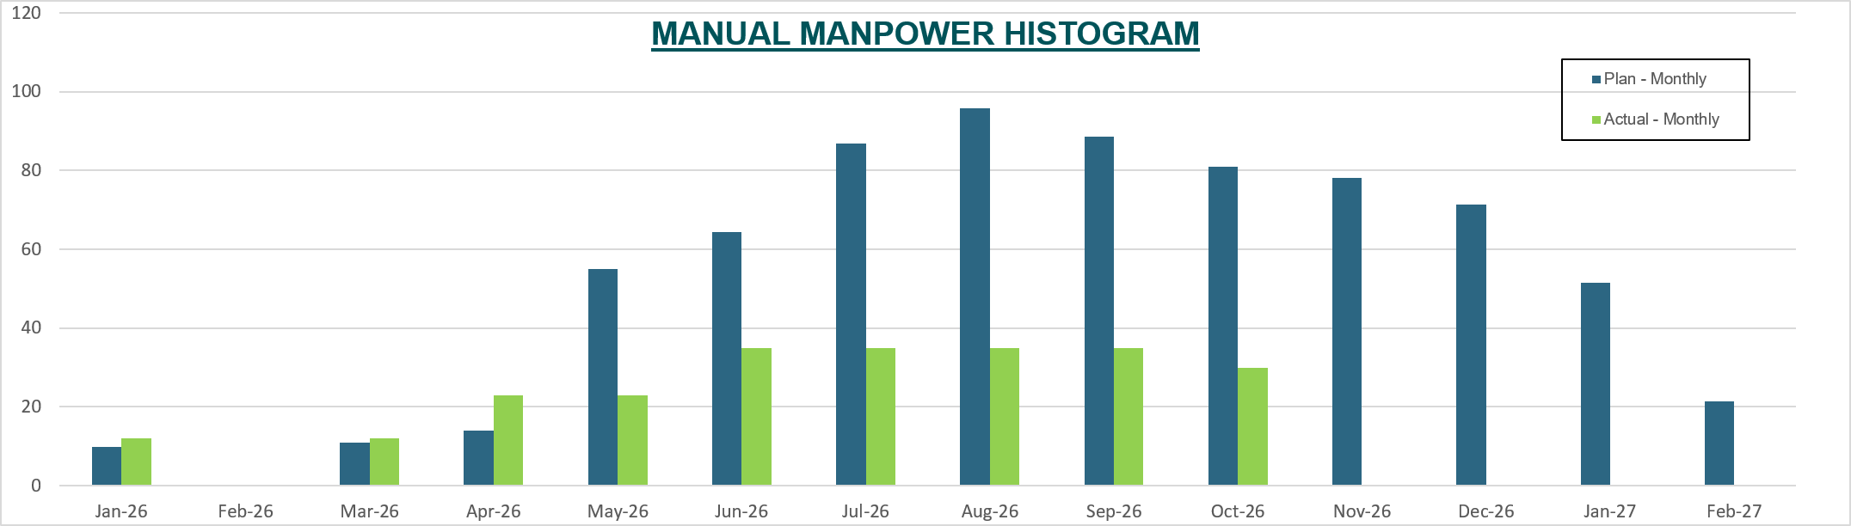
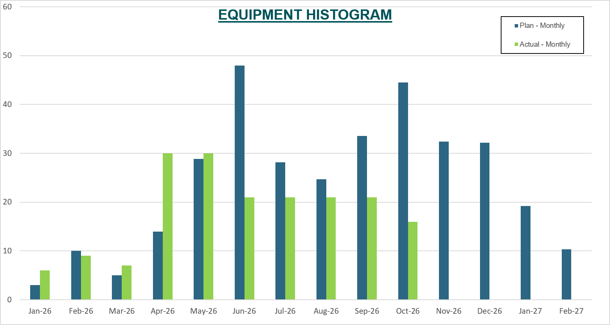
Weekly Report Areas / Resources
Resources
Manpower will be tracked per the approved plan to include manual and non-manual and will also monitor the actual average manpower with a forecast till the completion of the project. It will also include the manpower by craft or category (man-hours, man-days, crews, etc.) from approved primavera schedule.
Note that the actual data are not mandays, it will be average per month.
Equipment will be similar to the manpower. However, it will include in the table how many equipment at site are idle.

Slide 29
Weekly Report Areas / Schedule Status
Primavera P6 Schedule Status
Schedule Statistics
Total Act: The number activities in the schedule
Not Started The number of activities not started yet (from P6 schedule run report)
In Progress: The number activities in the schedule that have been started, but not completed. (from P6 schedule run report)
Completed: Then number of activities completed so far. (from P6 schedule run report)
Active Schedule Activities
Active: The number of activities in progress (same as above; no entry required)
Ahead: Total number of activities ahead of schedule
On/Behind: Number of activities on schedule / Behind schedule
Critical Path Activities
Last Week: The number of activities on the critical path up to the last week (Cumulative)
This Week: The number of activities on the critical path up to this week. (Cumulative)
Free Float Management
Greater than 14 days: The number of activities with free float greater than 14 days for last week and this week.
Less than 14 days: The number of activities with free float less than 14 days for last week and this week.
Failed Starts
Last Week: Total activities failed to start as planned until last week.
This Week: Total activities failed to start as planned until this week.
Min.Float: Minimum Float value of any of the activity in the schedule i.e (Maximum negative float of any activity)

Slide 30
Weekly Report Areas / Testing and Commissioning
Testing And Commissioning
Testing and Commissioning items should be agreed upon at the start of the project between the contractor/consultant and MODON.
It should include the planned start and finish dates originally from approved baseline schedule. Contractor will be updating the forecast/actual start and finish dates per the development of the project.
Also, when the system testing has started, it is important to maintain the progress completion percentage of the whole system and the punch list status.

Slide 31
Weekly Report Areas / Issues
Active Issues
Issue Log will contain the top five active issues that are critical to the project and it should be extracted on weekly basis from the risk registrar.
Date Identified: Date of which the issue has been identified.
Issue description: a brief description of the issue and should identify the cause of the issue.
Responsibility: Dropdown list for responsible party.
Action Taken: The action that contract/consultant/MODON has taken to resolve the issue.
Mitigation: The recommended course of action to mitigate the current issue.
Current Status: Dropdown list for current status.
Expected/Actual Closure: Forecast/Actual date of issue closure.
Duration Elapsed: Automatically calculated cell based date identified and actual closure date.
.

Slide 32
شكراً

